Slide 1
PNR Status Confirmation Prediction
Name: Yogalakshmi Sethuraman
Date: 1/6/24
Phone: 9840273070
Email id: yoga_dwhprofessional@hotmail.com

Slide 2
Contents
Objective
Data Collection
Data Information
Data Preprocessing
Exploratory Data Analysis
Feature Selection
Modeling
Hyperparameter Tuning
Model Accuracy
Model Output
Notes:
Change

Slide 3
Objective
To Create a list of indicators that can be used to predict the chances of a ticket gettting confirmed after train chart preparation

Slide 4
Data Collection
Dataset was collected from Kaggle
Dataset URL: https://www.kaggle.com/competitions/railofy-challenge/data

Slide 5
Data Information
Feature | Description
GRCA: General Reservation Current Availability | Indicates the number of currently available seats in the general reservation category.
CCA: Current Charted Availability | The number of seats available after the chart has been prepared
JD: Journey Date | The date of the journey for which the ticket is booked
ODD: Origin-Destination Distance | The distance between the boarding station and the destination station
JS: Journey Start | The time when the journey begins
ODS: Origin-Destination Station | Code or indicator of the stations involved in the journey
SL: Sleeper Class | Indicates the number of seats or bookings in the Sleeper Class.
NDTD: Number of Days to Travel Date | The number of days left until the journey date from the date of booking
CURP: Current Upgraded Reservation Percentage | The percentage of reservations that have been upgraded (e.g., from RAC to confirmed)
GROP: General Reservation Occupancy Percentage | The percentage of general reservation seats occupied
CANP: Cancellation Percentage | The percentage of tickets that have been canceled
SBRA: Sleeper Berth Reservation Availability | Availability of sleeper berths at the time of query
SCRA: Sleeper Class Reservation Availability | Number of available seats in the Sleeper Class
GRA: General Reservation Availability | Indicates the availability of seats in the general category
CURA: Current Upgraded Reservation Availability | Number of available upgraded reservations
Feature | Description
RPW: Reservation Probability Weight | A calculated weight indicating the likelihood of reservation confirmation.
CUCA: Current Unreserved Seat Availability | Number of unreserved seats available currently.
CAR: Confirmed Against RAC | Number of RAC tickets that have been confirmed
BKT_2: Bucket 2 | Could represent a specific category or quota bucket used in allocation.
CL_1: Class 1 | Number of bookings or availability in the highest travel class (could be AC First Class).
CL_2: Class 2 | Number of bookings or availability in the second-highest travel class (could be AC 2-Tier)
CL_3: Class 3 | Number of bookings or availability in the third-highest travel class (could be AC 3-Tier)

Slide 6
Data Preprocessing
pk column was dropped
Outliers were capped with upper bound and lower bound values
Label encoding was implemented for the Quota feature
Notes:
Keep observations

Slide 7
Exploratory Data Analysis [EDA]
Outliers were found using boxplots
Distribution of categorical columns were found
Distribution of label was found to be highly imbalanced
sweetviz has been used for EDA. Generates EDA as a file sweetviz_report.html
Notes:
EDA is used for seeing what the data can tell us before the modeling task.
Change

Slide 8
Feature Selection
Feature importance for 12 columns were found using ExtraTreesClassifier
Feature importance for 12 columns were found using Mutual Info Classifier
GROP', 'CURP', 'CUCA', 'GRCA', 'CANP', 'ODD', 'NDTD', 'CCA', 'RPW', 'JD', 'SCRA', 'SBRA are the key indicators for predicting the chances of a ticket gettting confirmed after train chart preparation

Slide 9
Model Building
Classification models such as Logistic Regression, RandomForest Classifier, Extra Gradient Boosting Classifier, Support Vector Model Classifier, K-Nearest Neighbors Classifier and DecisionTree Classifier were used for prediction
Notes:
classification is the task of predicting a discrete class label. Regression is the task of predicting a continuous quantity.
What is classification techniques in machine learning?
The Classification algorithm is a Supervised Learning technique that is used to identify the category of new observations on the basis of training data. In Classification, a program learns from the given dataset or observations and then classifies new observation into several classes or groups.
What is regression techniques in machine learning?
Regression is a technique for investigating the relationship between independent variables or features and a dependent variable or outcome. It's used as a method for predictive modeling in machine learning, in which an algorithm is used to predict continuous outcomes.

Slide 10
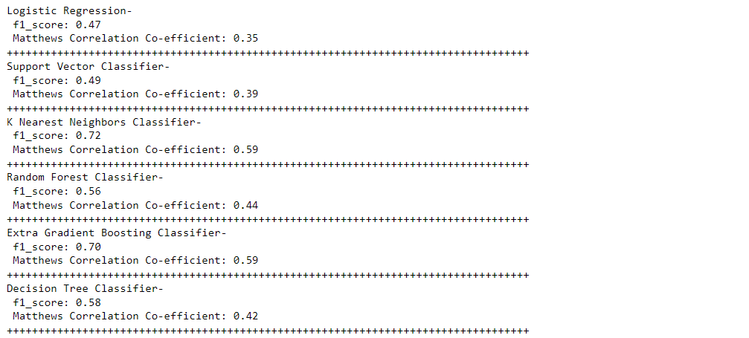
Model Accuracy Comparison
Extra Gradient Boosting Classifier and K-Nearest Neighbors Classifier gave a better scoring when compared to the other models
F1- score and Matthews Correlation Coefficient were used since the dataset is highly imbalanced
Notes:
classification is the task of predicting a discrete class label. Regression is the task of predicting a continuous quantity.
What is classification techniques in machine learning?
The Classification algorithm is a Supervised Learning technique that is used to identify the category of new observations on the basis of training data. In Classification, a program learns from the given dataset or observations and then classifies new observation into several classes or groups.
What is regression techniques in machine learning?
Regression is a technique for investigating the relationship between independent variables or features and a dependent variable or outcome. It's used as a method for predictive modeling in machine learning, in which an algorithm is used to predict continuous outcomes.

Slide 11
HyperParameterTuning
Hyper Parameters for K- Nearest Neighbors :
'n_neighbors':[3,5,7,10],
'weights':['distance','uniform'],
'algorithm':['ball_tree','kd_tree'],
'leaf_size':[20,30,40], 'p':[1,2]
Hyper Parameters for Extra Gradient Boosting Classifier :
'n_estimators': [100, 200, 300],
'learning_rate': [0.01, 0.1,0.001],
'max_depth': [3, 5, 7],
'gamma': [0, 0.1, 0.2]
Notes:
Why Random Forest Regression is good?
A Random Forest Regression model is powerful and accurate. It usually performs great on many problems, including features with non-linear relationships
How is XGBoost different from random forest?
One of the most important differences between XG Boost and Random forest is that the XGBoost always gives more importance to functional space when reducing the cost of a model while Random Forest tries to give more preferences to hyperparameters to optimize the model..
n_estimators — the number of decision trees you will be running in the model

Slide 12
Model Accuracy Comparison
Extra Gradient Boosting Classifier:
-F1 score: .807
-Matthews Correlation Coefficient: .725
K - Nearest Neighbors Classifier:
-F1 score: .872
-Matthews Correlation Coefficient: .815
Notes:
classification is the task of predicting a discrete class label. Regression is the task of predicting a continuous quantity.
What is classification techniques in machine learning?
The Classification algorithm is a Supervised Learning technique that is used to identify the category of new observations on the basis of training data. In Classification, a program learns from the given dataset or observations and then classifies new observation into several classes or groups.
What is regression techniques in machine learning?
Regression is a technique for investigating the relationship between independent variables or features and a dependent variable or outcome. It's used as a method for predictive modeling in machine learning, in which an algorithm is used to predict continuous outcomes.

Slide 13
Best Model –K Nearest Neighbor
K - Nearest Neighbors Classifier:
-F1 score: .872
-Matthews Correlation Coefficient: .815
Notes:
Why Random Forest Regression is good?
A Random Forest Regression model is powerful and accurate. It usually performs great on many problems, including features with non-linear relationships
How is XGBoost different from random forest?
One of the most important differences between XG Boost and Random forest is that the XGBoost always gives more importance to functional space when reducing the cost of a model while Random Forest tries to give more preferences to hyperparameters to optimize the model..
n_estimators — the number of decision trees you will be running in the model

Slide 14
Key Indicators
CURP: Current Upgraded Reservation Percentage
GROP: General Reservation Occupancy Percentage
CUCA: Current Unreserved Seat Availability
NDTD: Number of Days to Travel Date
GRCA: General Reservation Current Availability
ODD: Origin-Destination Distance
CANP: Cancellation Percentage
JD: Journey Date
CCA: Current Charted Availability
RPW: Reservation Probability Weight
ODS: Origin-Destination Station
JS: Journey Start

Slide 15
Technical Stacks
sweetviz
ensemble
Flask
joblib
matplotlib
numpy
pandas
scikit_learn
seaborn
xgboost
linear_model
svm
neighbors
tree
metrics
model_selection

Slide 16
Model Deployment - Strategy
Model was deployed using Flask in the file app.py
Endpoint was defined as ‘/predict’
Test file was read and stored in variable input_data
All preprocessing steps such as dropping columns, removing outliers and label encoding were applied within a function before predicting the model
Also, feature selection has been implemented to select the top 12 most influential columns that help in predicting the model
Code was executed using python app.py
Predictions were returned to the user as a file named predictions.csv

Slide 17
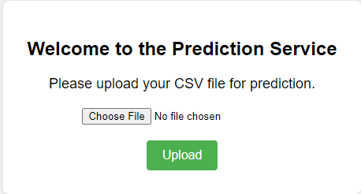
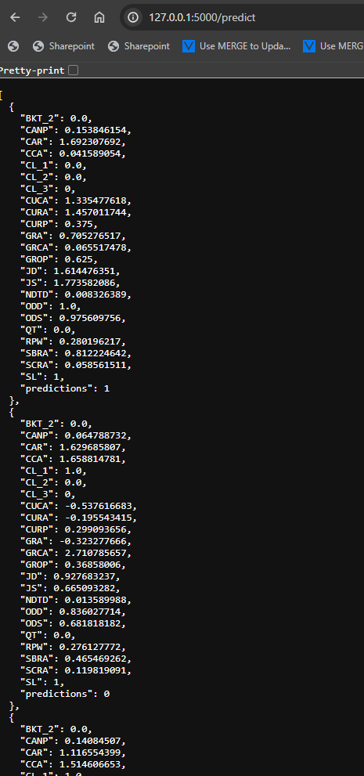
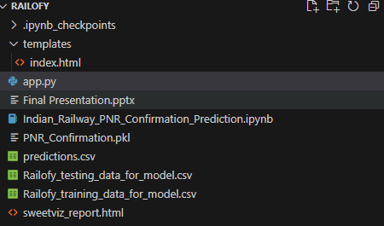
Model Output

Slide 18


